Slide 1
Xbee(transmitter) Interfacing with BBB wireless
Submitted by
Ashok Kumar Saini(c0762216)

Slide 2
What is Xbee?
XBee S2C is a RF module designed for wireless communication or data exchange and it works on ZigBee mesh communication protocols that sit on top of IEEE 802.15. 4 PHY.
The module provides wireless connectivity to end-point devices in any ZigBee mesh networks including devices from other vendors.

Slide 3


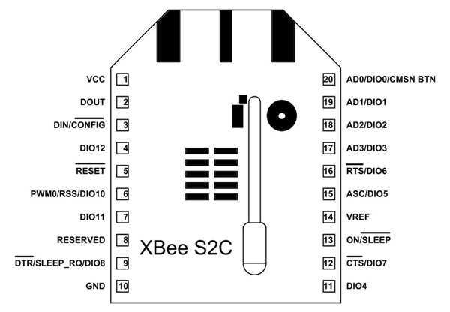

Pin Diagram of Xbee
z

Slide 4
Pin Configuration of Xbee
Pin | Name | Description
1 | VCC | Power supply
2 | DOUT/DIO13 | UART data out pin (TXD)/GPIO
3 | DIN/CONFIG / DIO14 | UART data in pin (RXD)/ GPIO
4 | DIO12/SPI_MISO | GPIO/ Master Input-Slave Output pin of SPI interface
5 | RESET | Module Reset pin
6 | RSS PWM /DIO10 | RX Signal Strength Indicator pin / GPIO
7 | PWM1/DIO11 | Pulse Width Modulator/GPIO

Slide 5
Pin Configuration of Xbee
Pin | Name | Discription
8 | RESERVED | Do not connect
9 | DTR/SLEEP_RQ/ DIO8 | Pin Sleep Control line /GPIO
10 | GND | Ground
11 | DIO4/ SPI_MOSI | GPIO/Master Output-Slave Input pin of SPI interface
12 | CTS/DIO7 | Clear-to-send flow control/GPIO
13 | ON_SLEEP/DIO9 | Device status indicator/GPIO
14 | VREF | Voltage Reference for ADC

Slide 6
Pin Configuration of Xbee
Pin | Name | Discription
15 | ASC/DIO5 | Associate Indicator/GPIO
16 | RTS/DIO6 | Request to send flow control/ GPIO
17 | AD3/DIO3/SPI_SSEL | Analog input/GPIO/SPI slave select
18 | AD2 /DIO2/SPI_CLK | Analog input/GPIO/SPI clock
19 | AD1/DIO1/SPI_ATTN | Analog input/GPIO/SPI attention
20 | AD0/DIO0/C | Analog input/GPIO/ Commissioning button

Slide 7
Features and Electrical Characteristic of Xbee
Transmission Frequency: 2.4GHz to 2.5GHz
Number of Channels: 16 Direct Sequence Channels
Featured with UART (250 Kb/s maximum) and SPI (5 Mb/s maximum) interface
Featured with software adjustable transmitting power
Indoor/Urban Range: 200ft
Outdoor RF line-of-sight Range: up to 4000ft
Transmit Power Output: 6.3mW (8dBm) in Boost mode,2mW (3dBm) in Normal mode

Slide 8
Features and Electrical Characteristic of Xbee
Receiver Sensitivity: -102dBm in Boost mode, -100dBm in Normal mode
Supply Voltage Range: +2.1V to +3.6V
Operating Current: 33mA (at3.3V, for Normal mode) , 45mA (at 3.3V,for Boost mode)
Idle Current: 9mA
Maximum output current on all pins together: 40mA
Power-down Current: <1uA @25C
ESD protection: 3000V
Operating Temperature: -40ºC to 85° C

Slide 9
Need of Xbee module !
As our project has two isolated part (transmitter/receiver ). We need to send Data from one part to other.
Xbee provides sufficient data rate (250Kbps).
Simplicity in configuration and interfacing with microcontrollers.
A single XBee module does not have much use unless you already have a ZigBee mesh network up and running. So if there is no mesh network working you need at least two modules for establishing wireless communication.

Slide 10
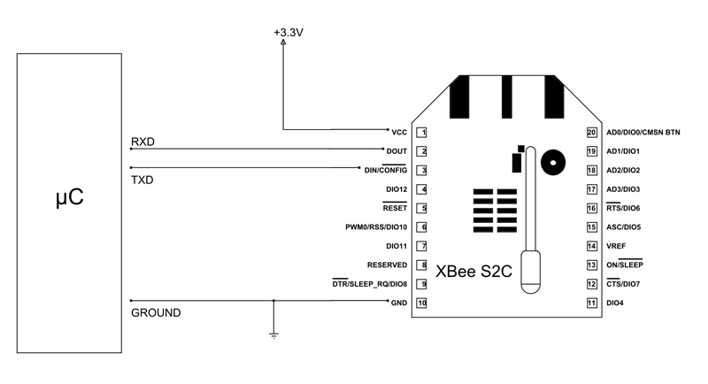
UART interfacing of Xbee

Slide 11
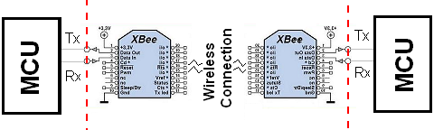
UART interfacing of Xbee

Slide 12
Software used for Xbee- XCTU
XCTU is a free, multi-platform application compatible with Windows, MacOS and Linux
Graphical Network View for simple wireless network configuration and architecture
API Frame Builder is a simple development tool for quickly building XBee API frames
Firmware Release Notes Viewer allows users to explore and read firmware release notes

Slide 13
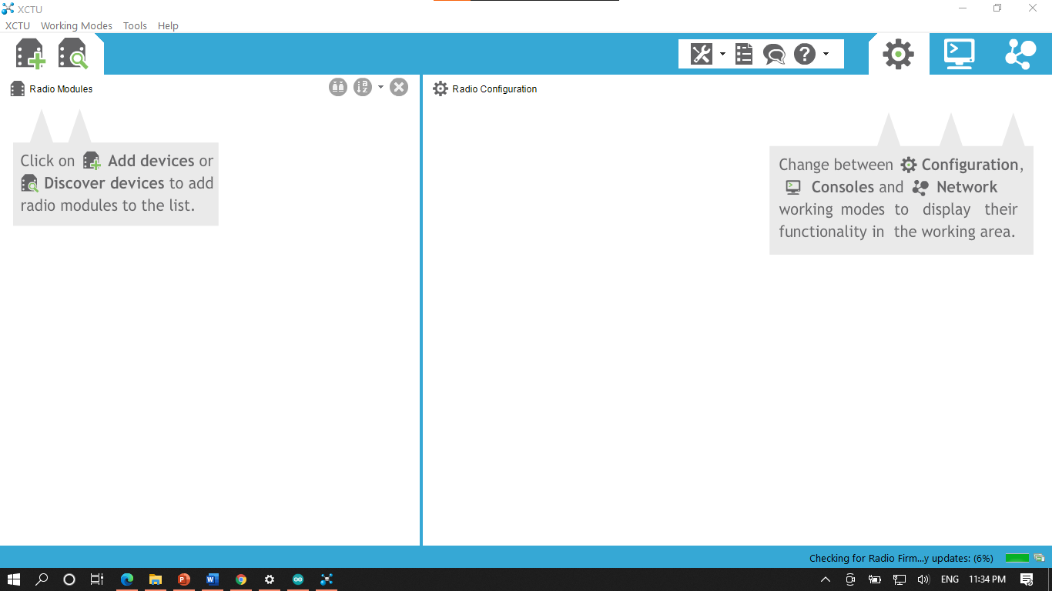
XCTU software

Slide 14
Configuring Xbee
PAN ID- Assign same for Both Xbees
MAC address (16 bits)
Xbee1 -> 0013A20041D157C6
Xbee2 -> 0013A20041D18631
High
Low
Node Identifier
CE Coordinator Enable

Slide 15
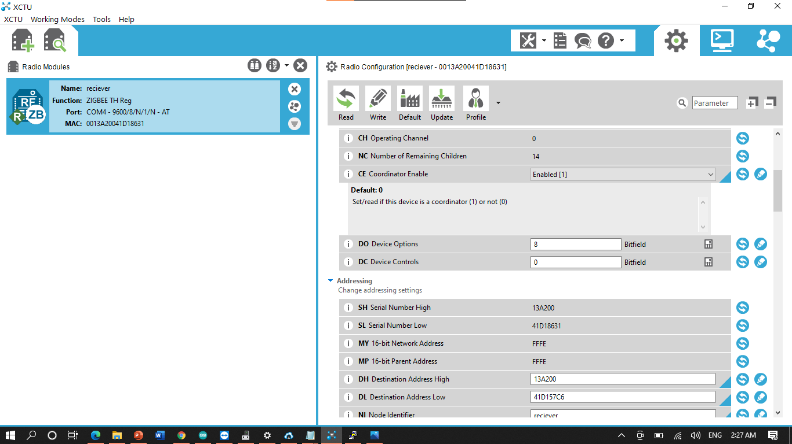

Slide 16
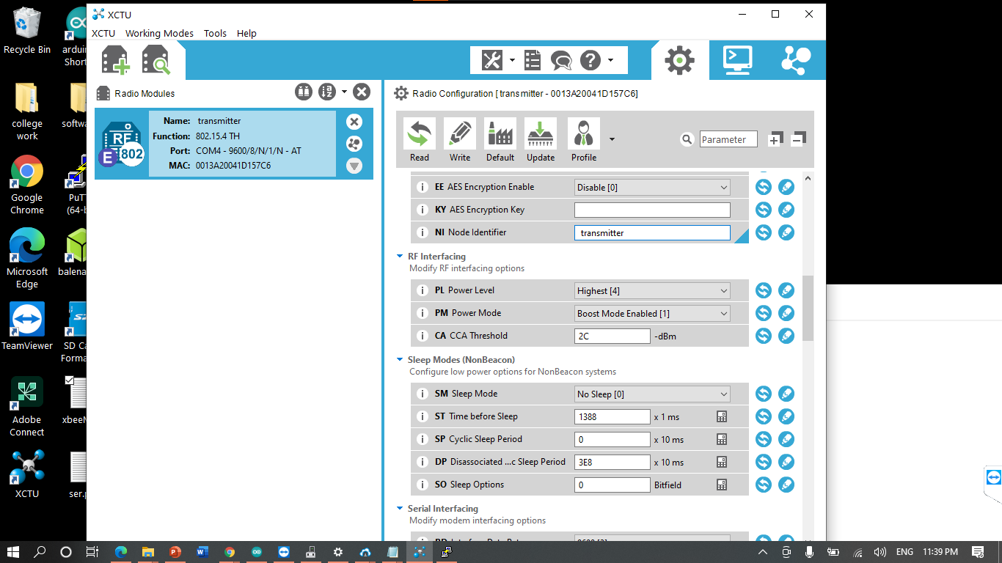
Xbee configuration as transmitter

Slide 17
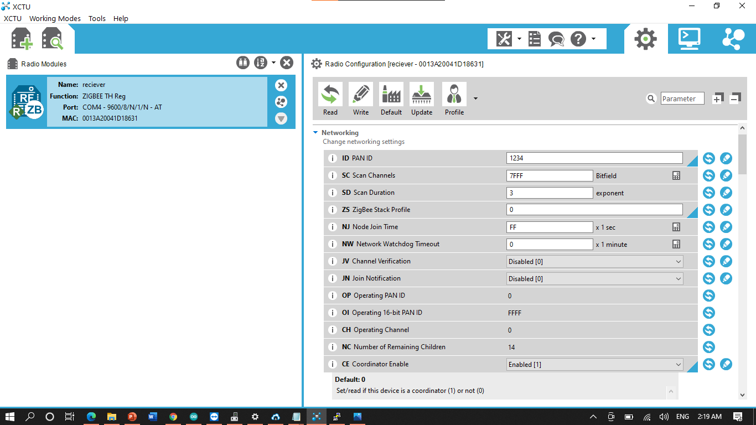
Xbee Configuration as Receiver

Slide 18
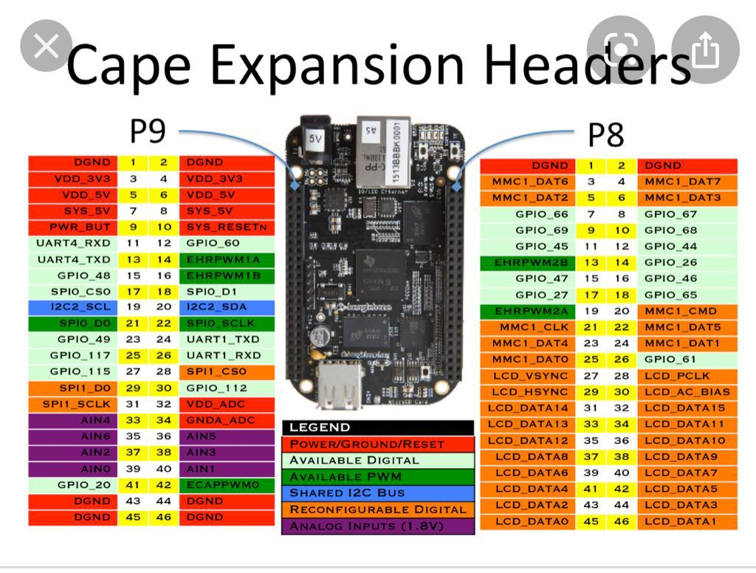
Pin Diagram of BBB wireless

Slide 19
Interfacing with BBB wireless
Connect pin 1 of Xbee to pin4 0f BBB wireless (P9 Header)
Connect pin 10 of Xbee to Pin 46 of BBB wireless (P9 header )
Connect pin 2 of Xbee to pin26 0f BBB wireless (P9 Header)
Connect pin 3 of Xbee to Pin 24 of BBB wireless (P9 header )

Slide 20
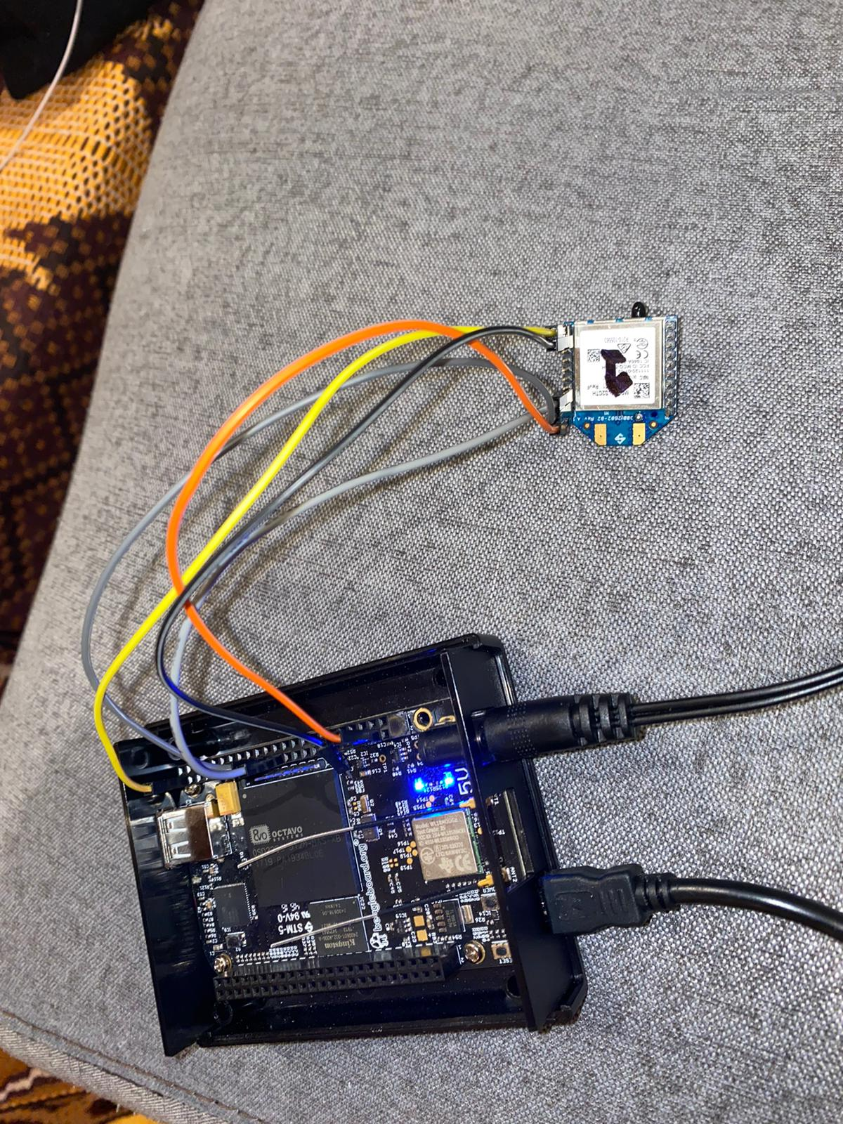

Slide 21
Interfacing with Arduino
Connect pin 1 of Xbee to 3.3V 0f Arduino uno wireless
Connect pin 10 of Xbee to GND Arduino uno
Connect pin 2 of Xbee to Tx of Arduino uno
Connect pin 3 of Xbee to Rx of Arduino uno

Slide 22
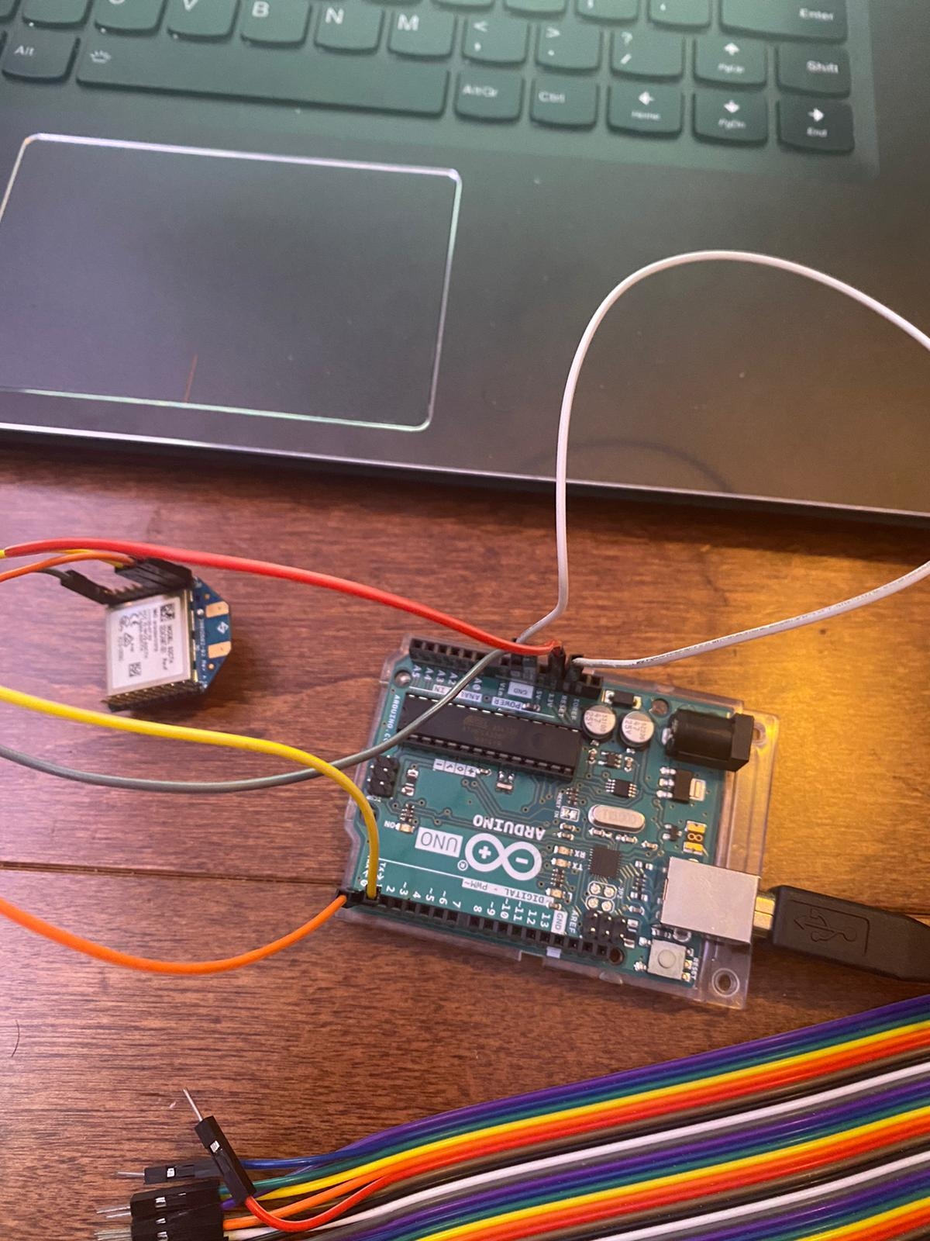

Slide 23
UART interfacing of Xbee using C
Add kernel Libraries
Save USB locations of Devices
Give Commands to Communicate with other Xbee

Slide 24
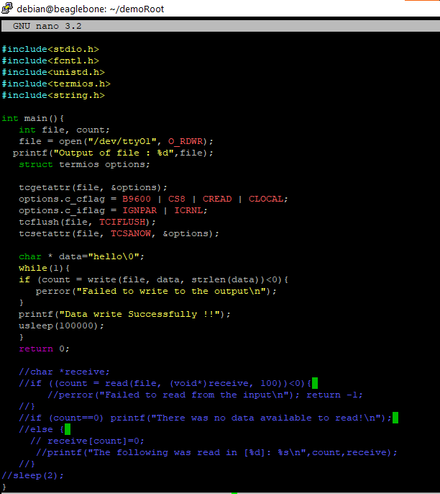

Slide 25
UART interfacing of Xbee using python
import Adafruit_BBIO.UART as uart
uart.setup('UART1')
import serial
xbee=serial.Serial(port="/dev/ttyO1", 9600, timeout=1)
while(1):
print(xbee.readline())
xbee.write('From Beaglebone')

Slide 26
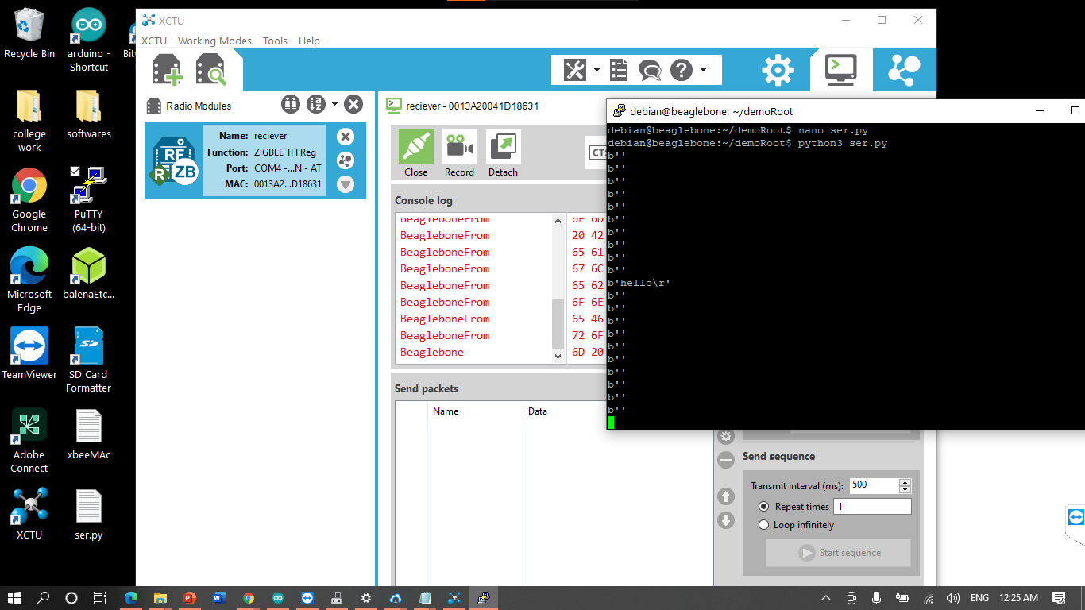

Slide 27
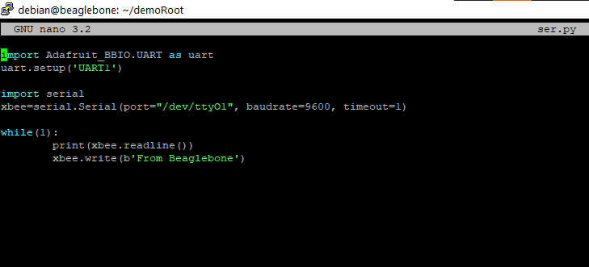

Slide 28
Reference
Xbee configuration
https://components101.com/wireless/xbee-s2c-module-pinout-datasheet#:~:text=XBee%20S2C%20is%20a%20RF,including%20devices%20from%20other%20vendors.
XCTU software
https://www.digi.com/products/embedded-systems/digi-xbee/digi-xbee-tools/xctu#productsupport-utilities

Slide 29
Reference
Interfacing of xbee
https://stackoverflow.com/questions/tagged/beagleboneblack?sort=votes&page=4
https://medium.com/@ing.david.mata/in-this-tutorial-i-am-going-to-show-you-how-you-can-send-data-wirelessly-between-an-arduino-to-a-cb18cac1c984

Slide 30
Questions? Thanks
z

